Slide 1
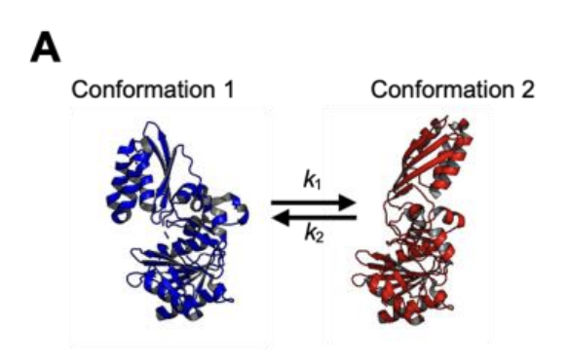
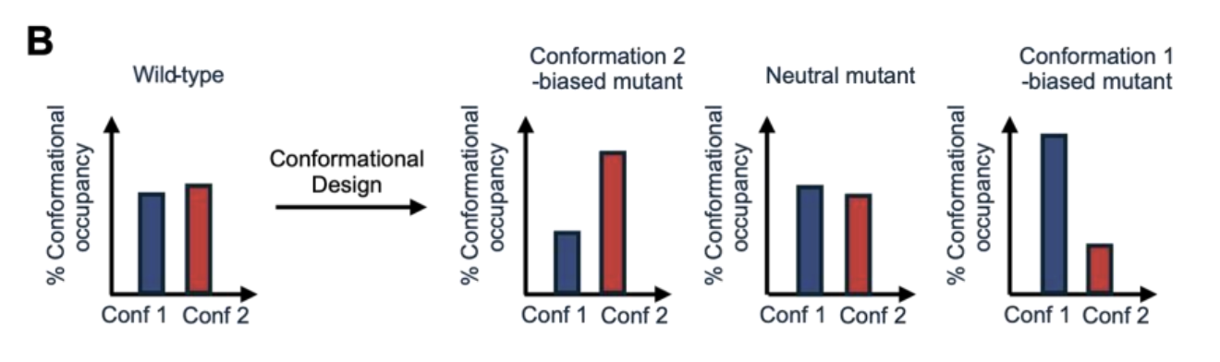
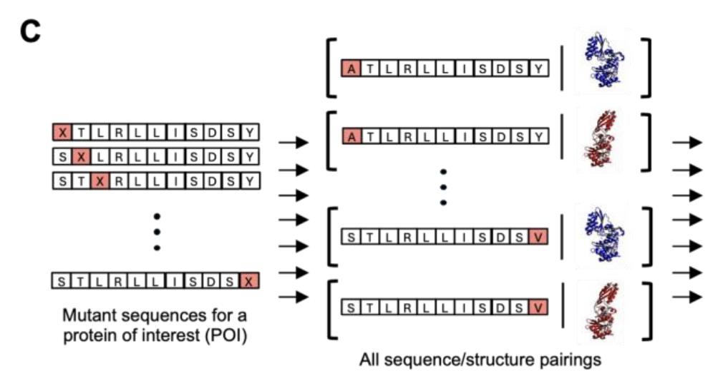
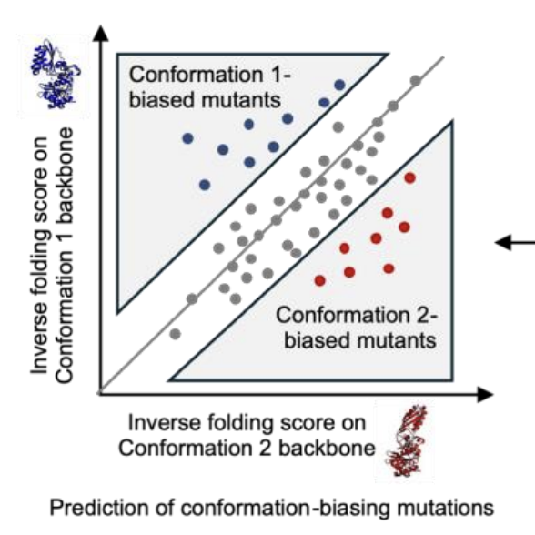
Inverse folding score on Conformation 1 backbone
Mutant sequences for a protein of interest (POI)
Inverse folding score on Conformation 2 backbone
Calculate MPNN scores for each possible mutant conditioned on conformation
Prediction of conformation-biasing mutants

Slide 2
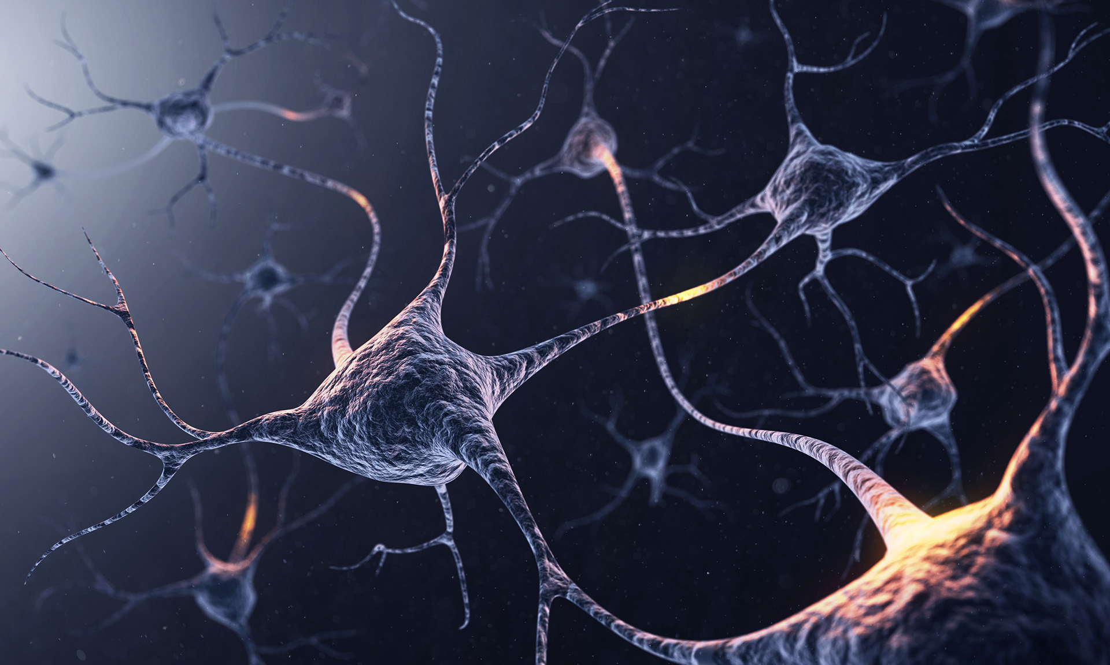
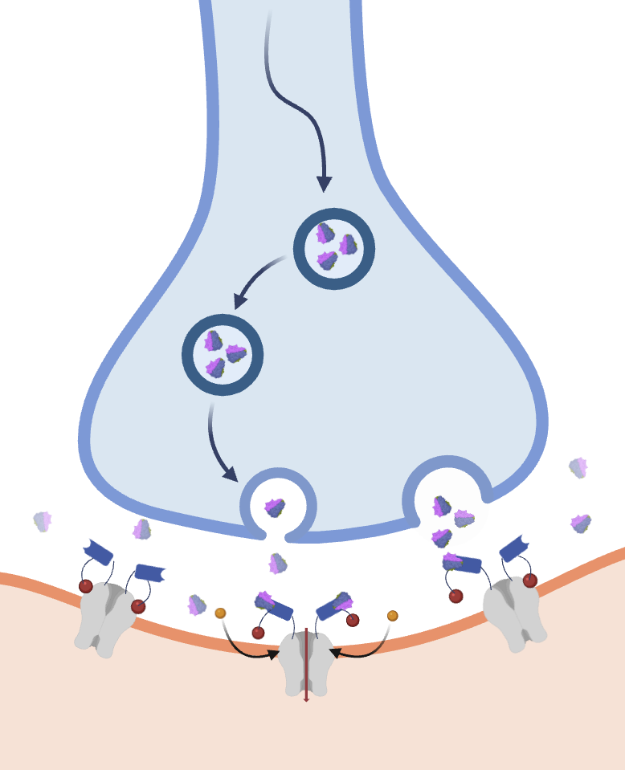

A
B
Antigen-Secreting Cell
Secretion of endogenous or recombinant antigen
Cell Body
Axon
Biorthogonal Agonist
Dendrites (Inputs)
Axon Terminals (Outputs)
Nucleus
MAGIC-Expressing Neuron
Activation or Inhibition

Slide 3
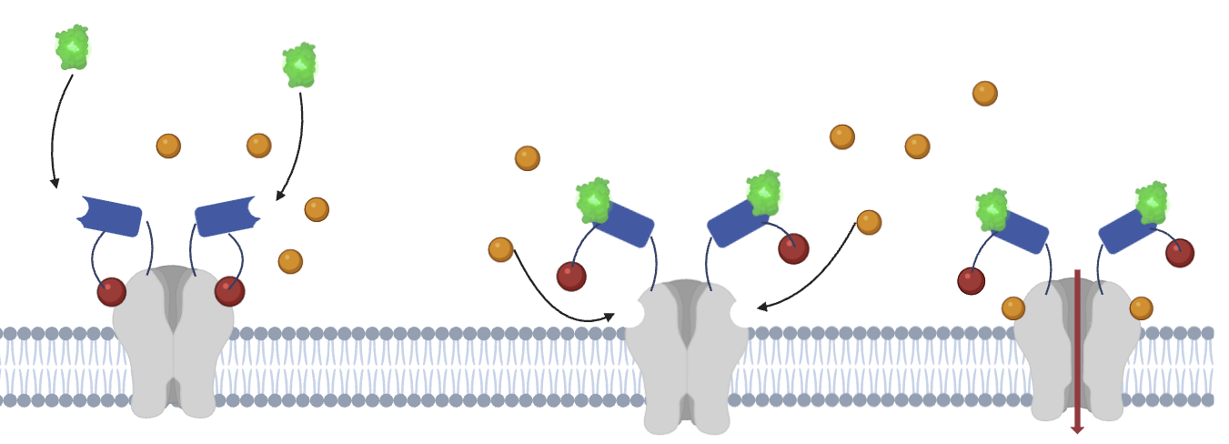
C
GFP
GFP binds to LaG2
Extracellular
Space
LaG2
Agonist
Toxin
Plasma Membrane
Channel
Channel blocked by lack of antigen
Antigen binding releases autoinhibition
Channel activated by agonist binding
Intracellular Space

Slide 4
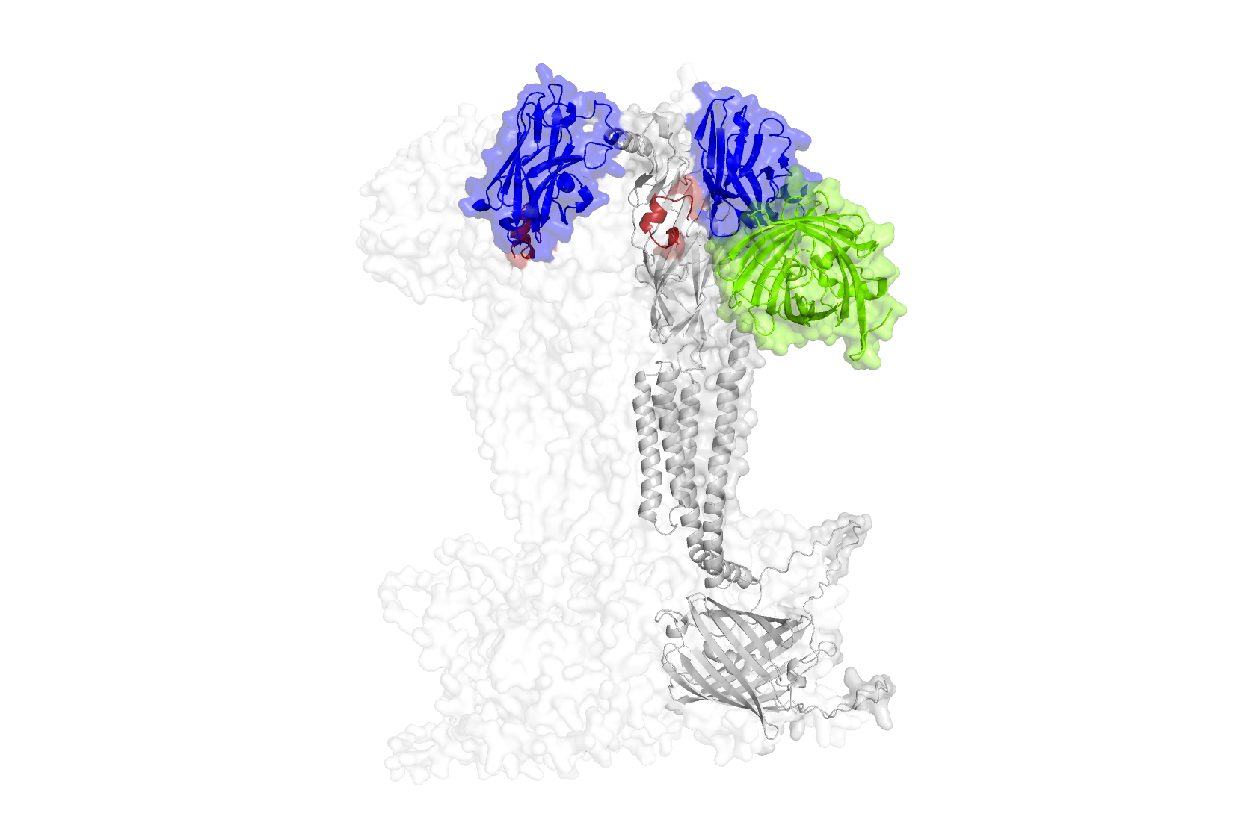
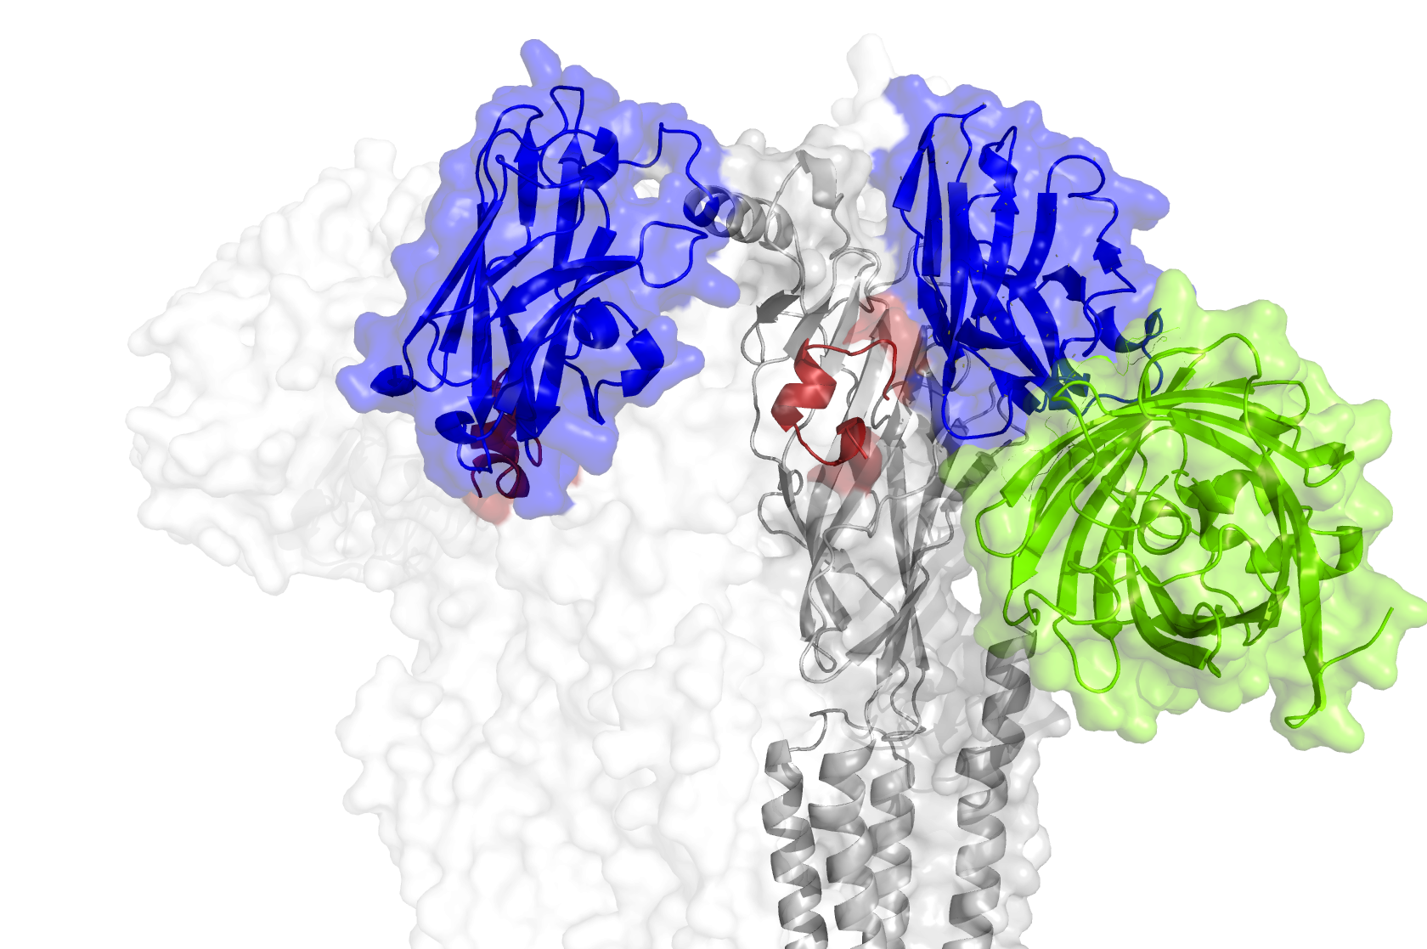
D
Chain 2
(Behind; subunit n inhibits n+1)
E
Chain 1
LaG2
Extracellular
Domain
Toxin
GFP
Transmembrane
Domain
Channel/GFP Clash

Slide 5
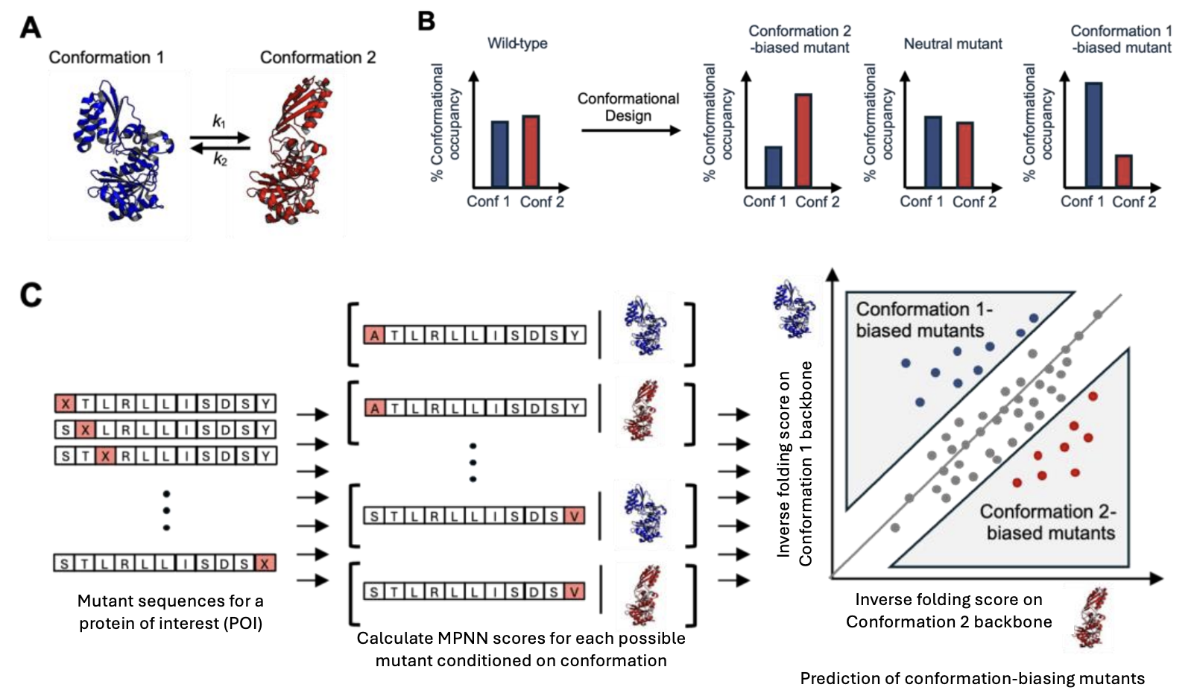
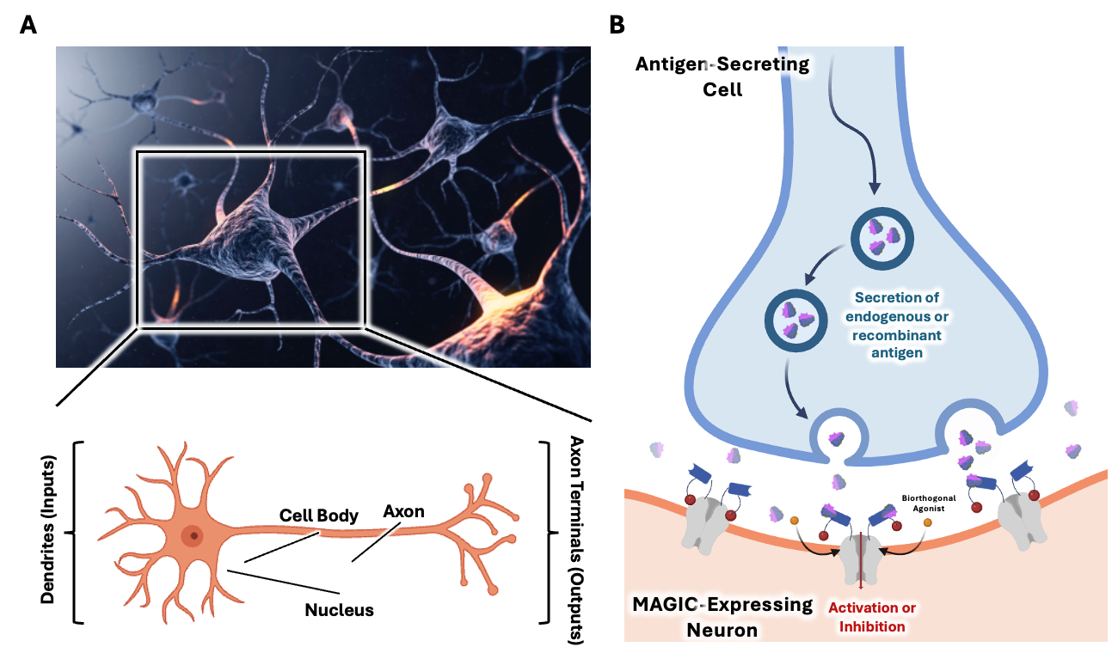
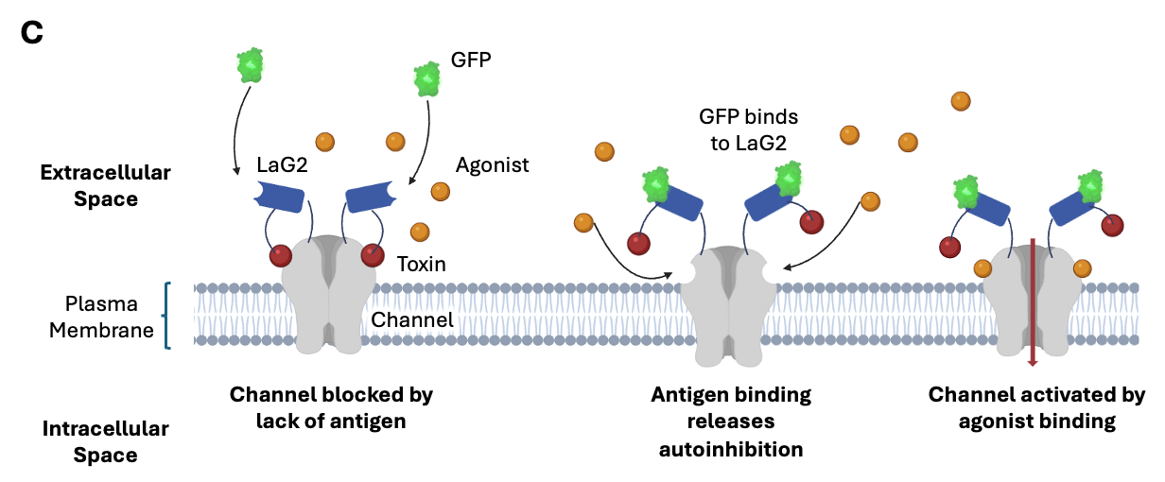
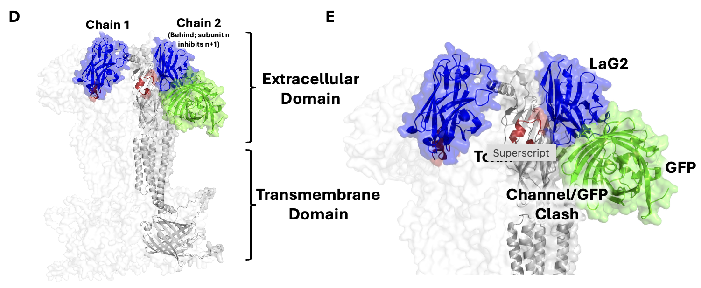

Slide 6
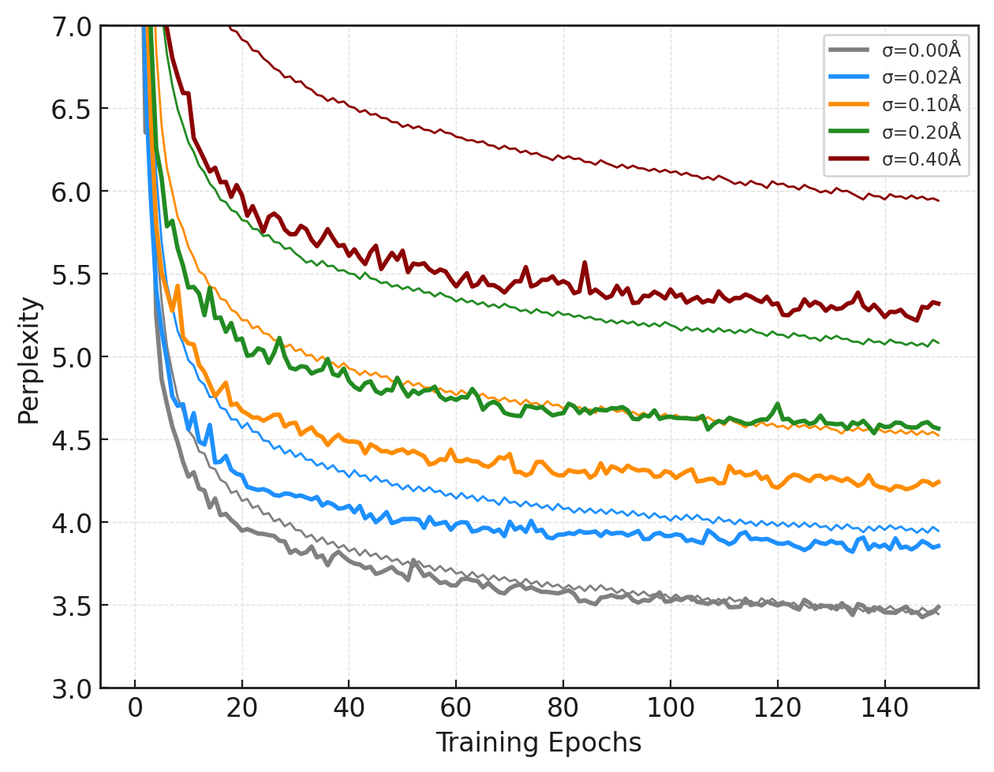
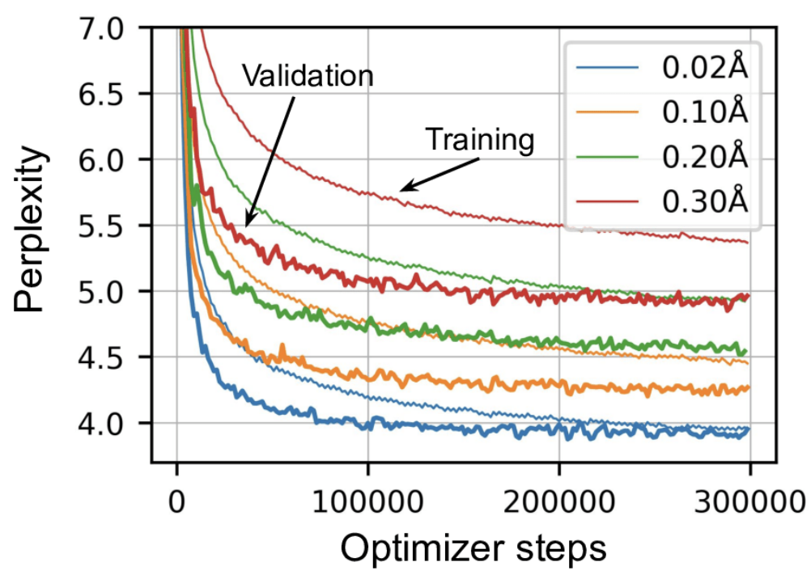
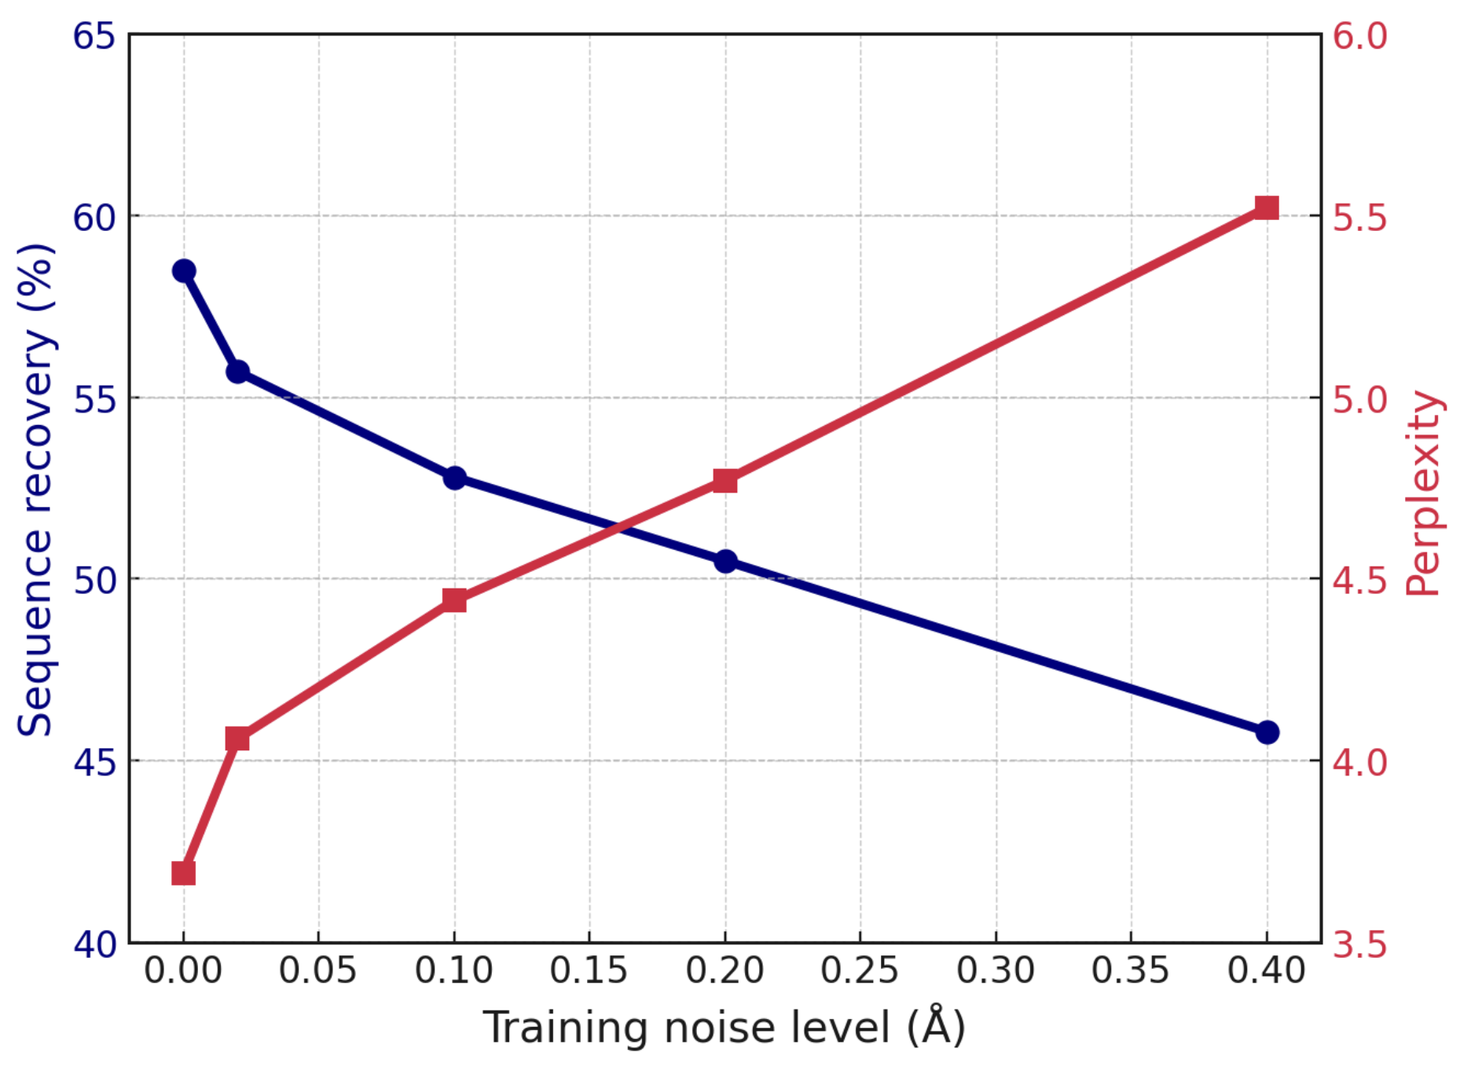
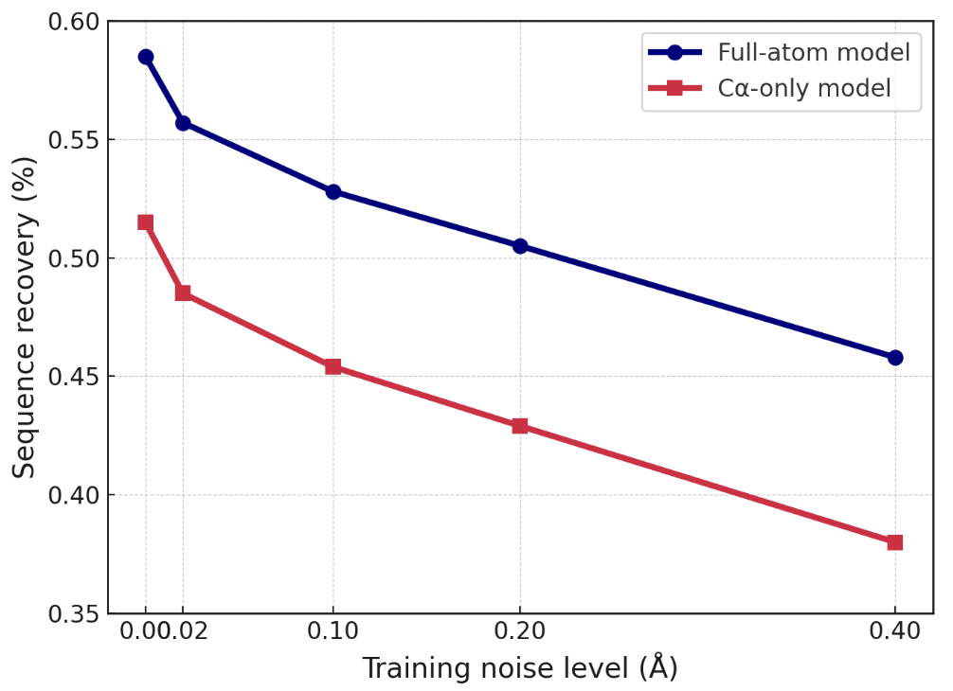
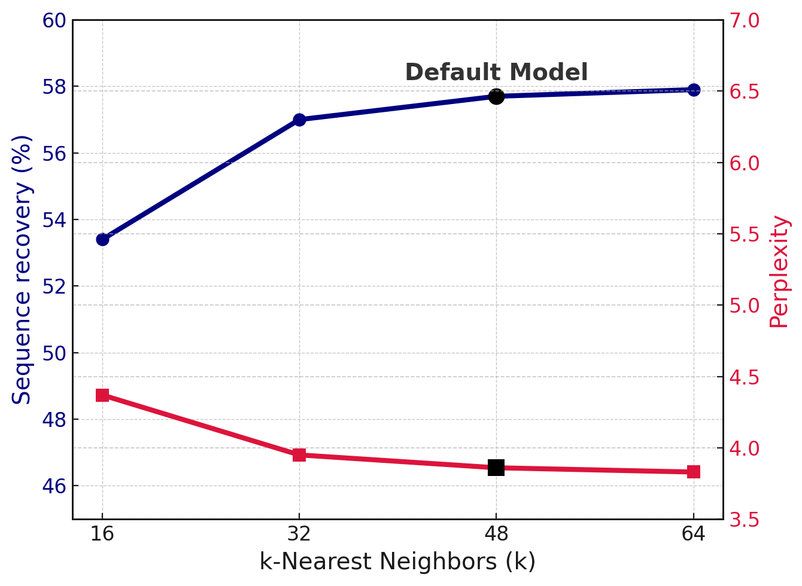
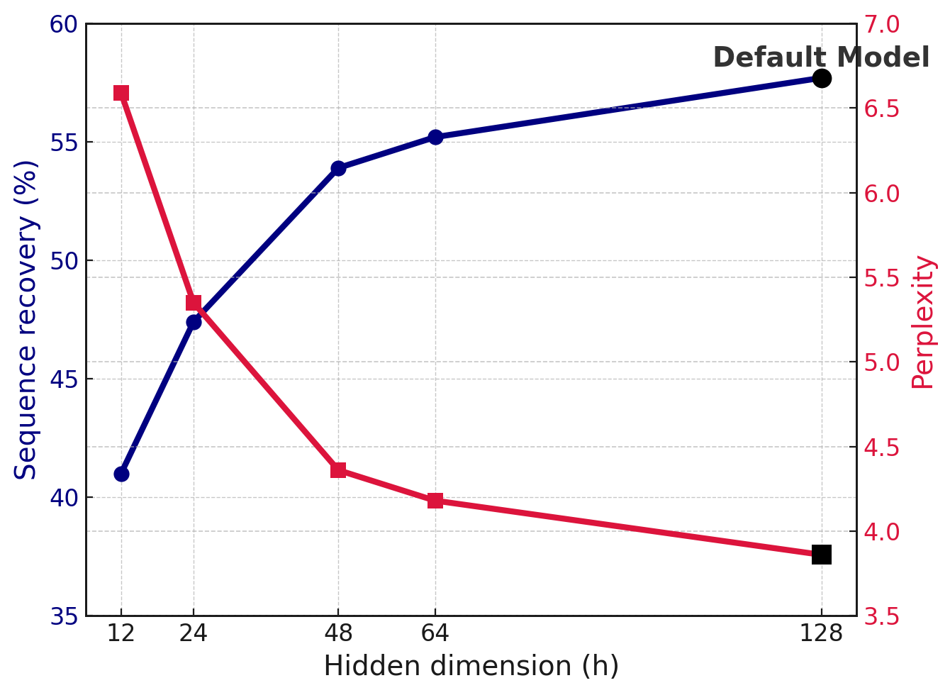
A
B
Training
Validation
C
D
E
F

Slide 7
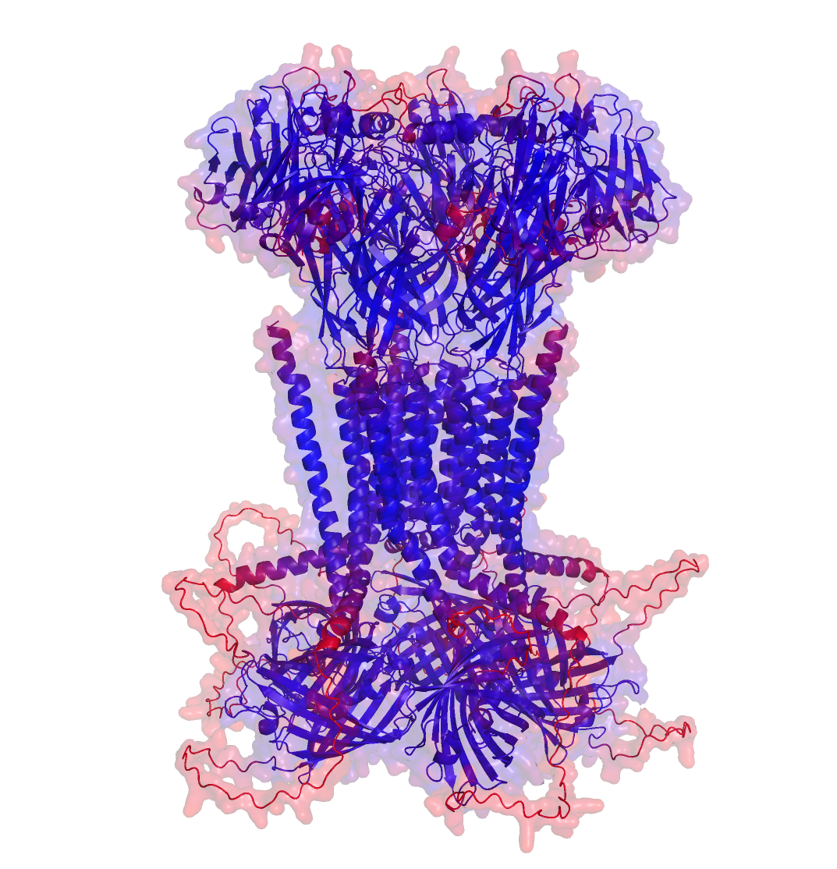
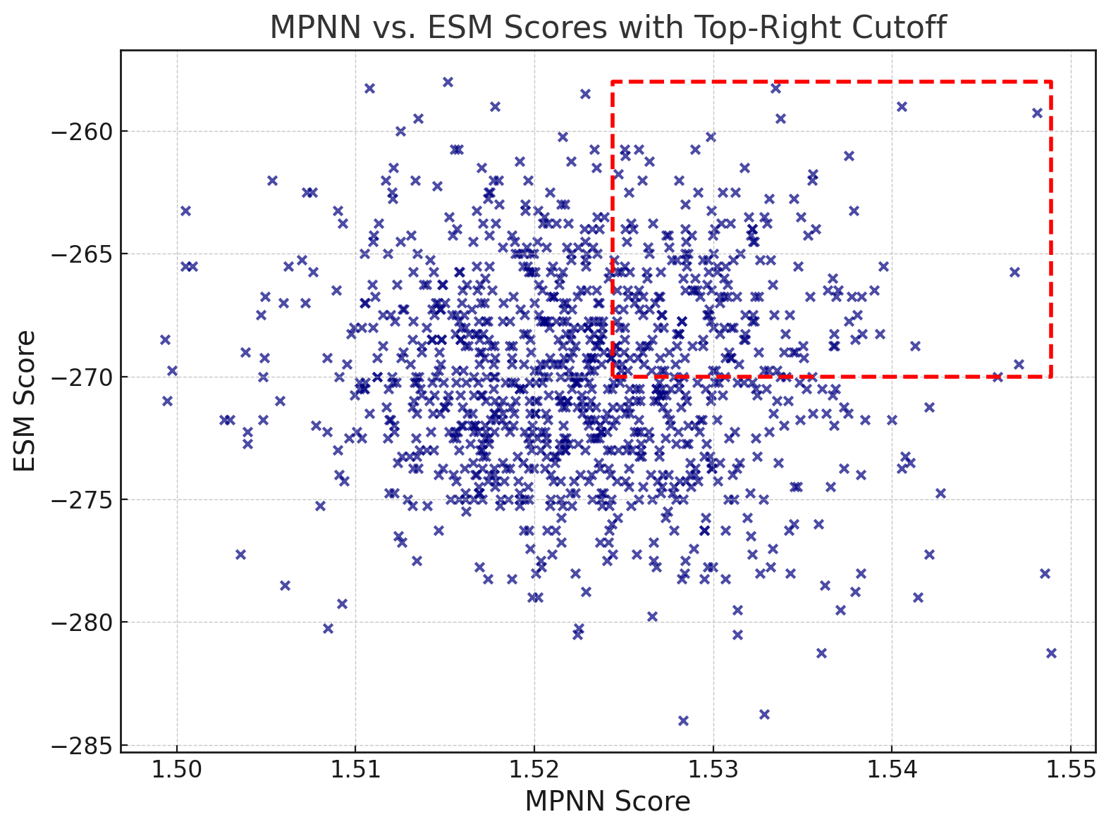
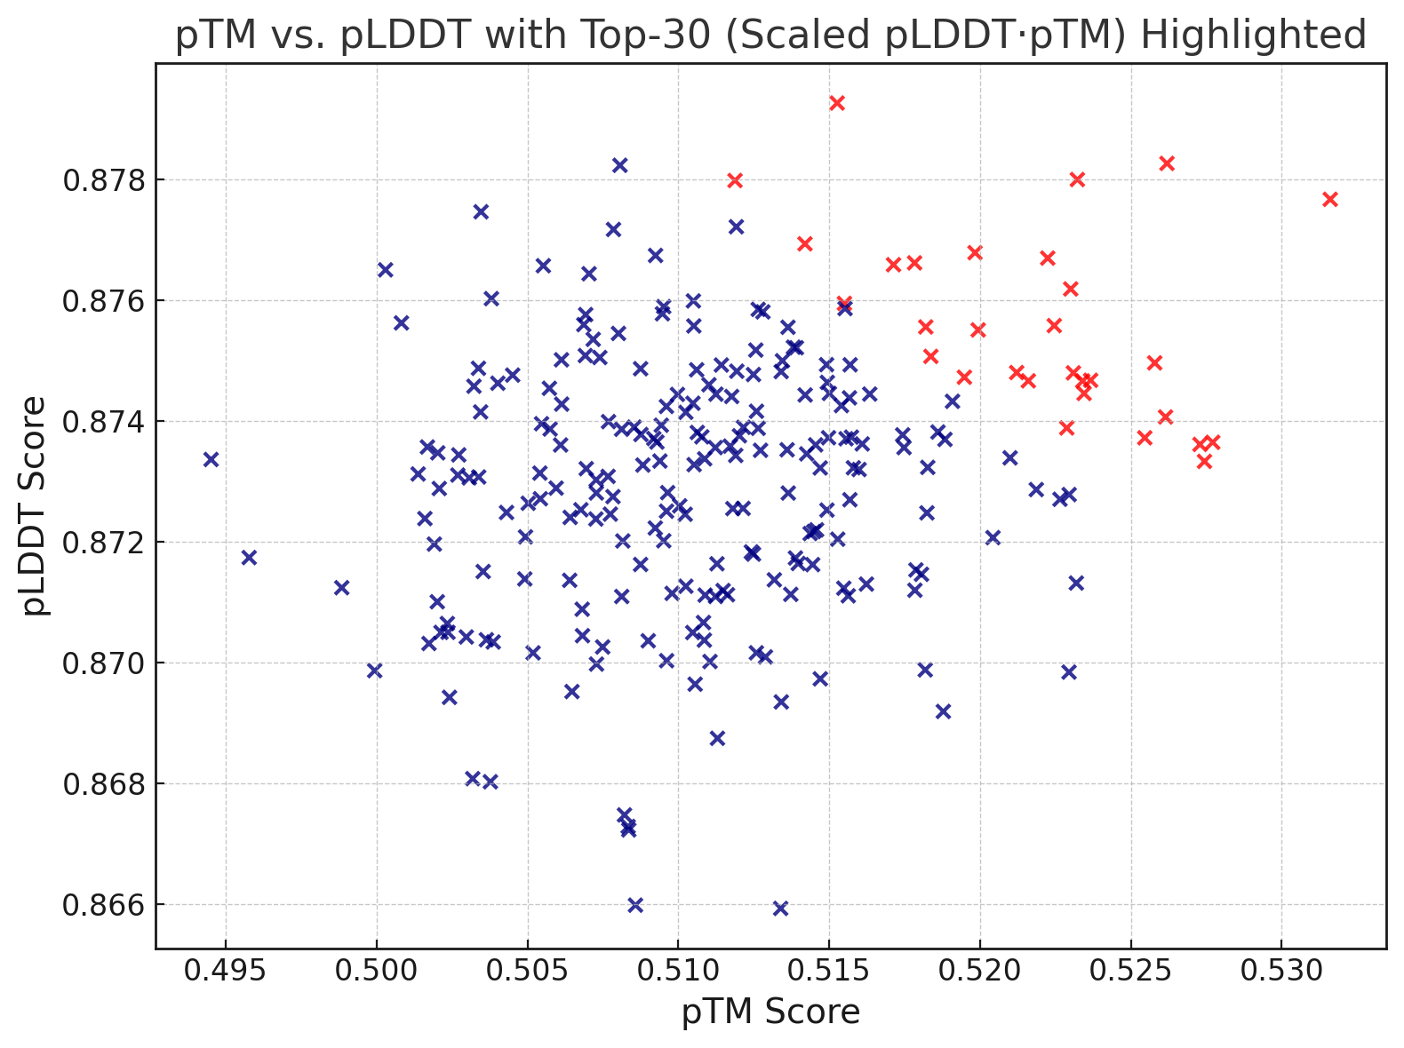
I
II
III
Native Sequence:
T
T
L
R
L
L
I
S
D
S
Y
A
T
L
R
L
G
I
S
D
S
S
S
C
L
R
L
L
I
S
C
S
Y
ESM2 Scores
S
T
V
R
L
L
F
S
D
S
Y
S
T
L
R
T
L
I
S
D
S
G
ProteinMPNN Score
Structure input from AlphaFold 3
Generate 1024 in-silico backbone redesigns of chimeric input
Calculate ProteinMPNN and ESM2 scores for all sequences and filter
VI
V
IV
S
T
V
R
L
L
F
S
D
S
Y
S
C
L
R
L
L
I
S
C
S
Y
ESM2 Scores
S
T
V
R
L
L
F
S
D
S
Y
S
T
L
R
T
L
I
S
D
S
G
S
T
L
R
T
L
I
S
D
S
G
30 Remaining probability sequences to validate in vitro
ProteinMPNN Score
~240 Remaining Probability Sequences
Calculate pTM, pLDDT with AF2 and filter

Slide 8
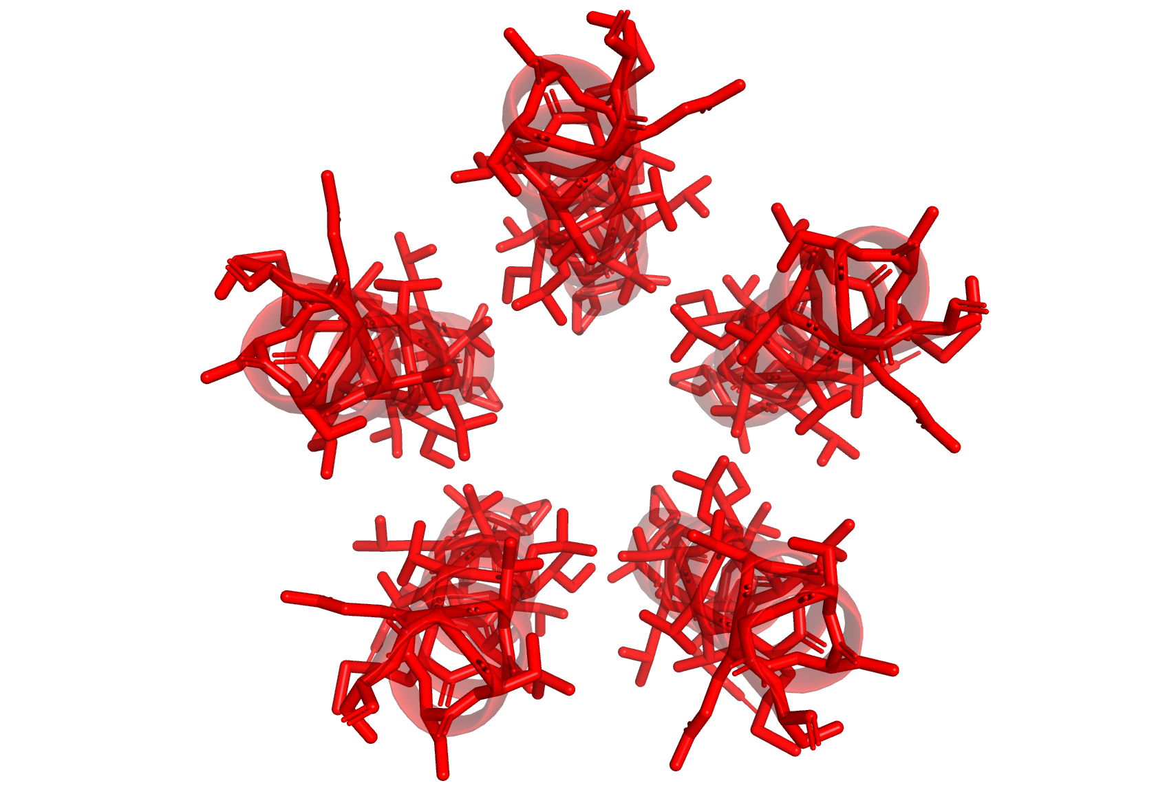
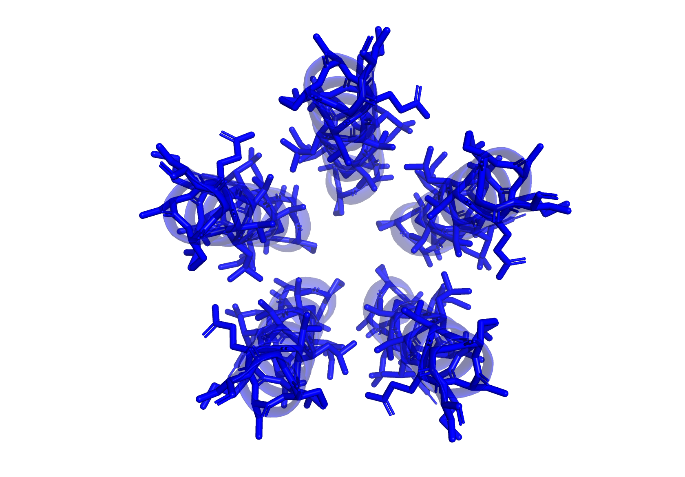
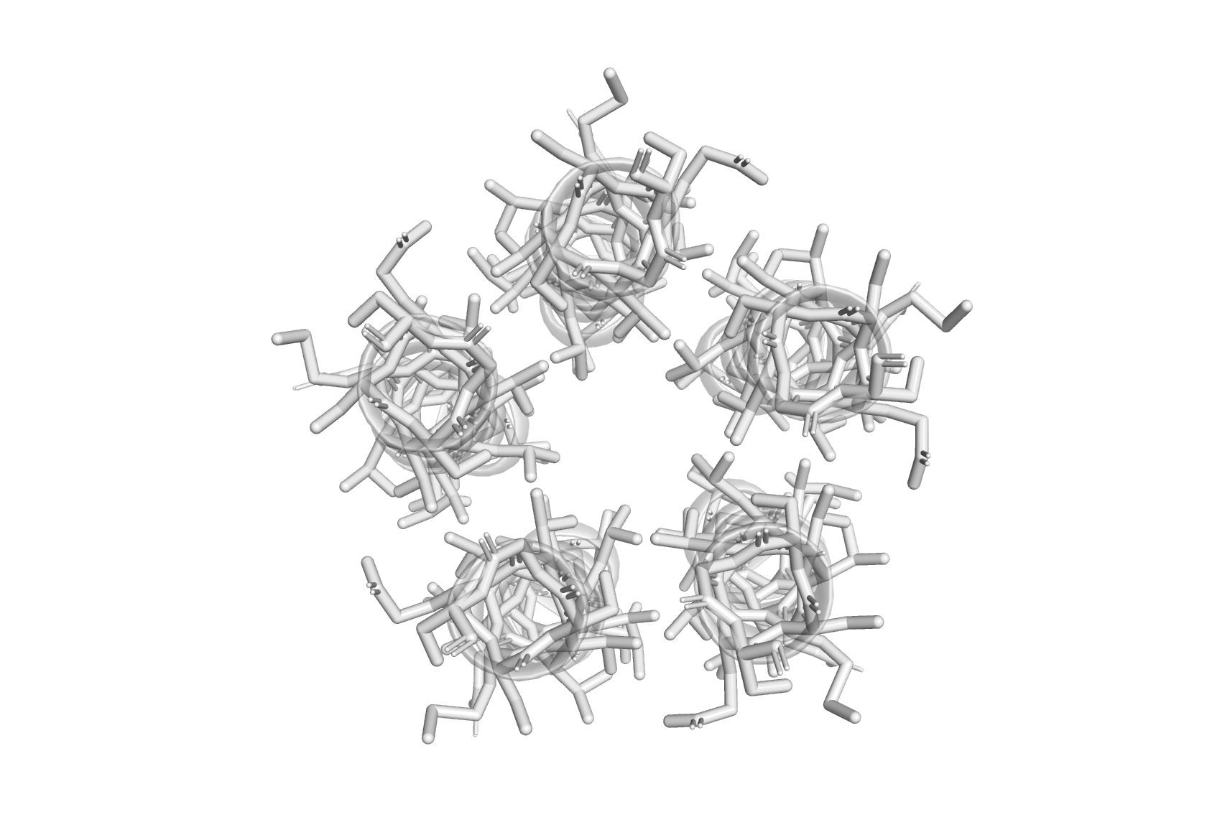
2.8Å
k_{desensitized}
1.5Å
k_{open}
Open vs. Desensitized
Desensitized vs. Closed
Open vs. Closed
k_{closed}
k_{desensitized}
Conformational Biasing
k_{open}
k_{closed}
Fractional occupancy
Fractional occupancy
Fractional occupancy
1.5Å
Desens-itized
Open
Desens-itized
Closed
Open
Closed

Slide 9
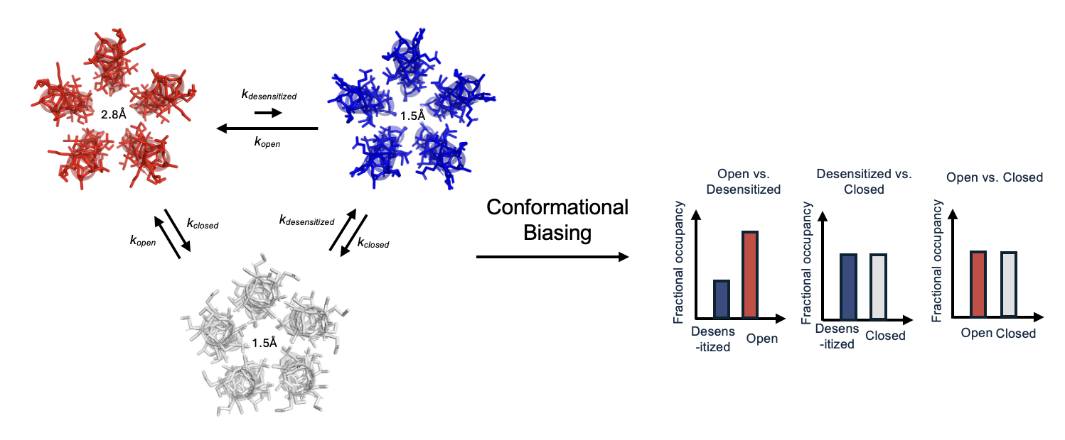
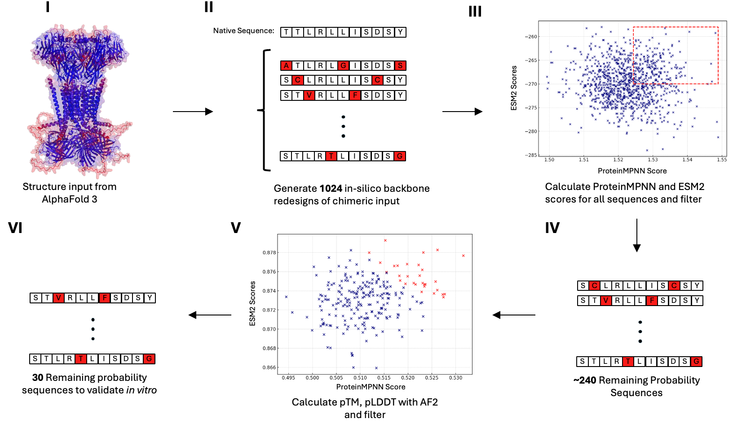
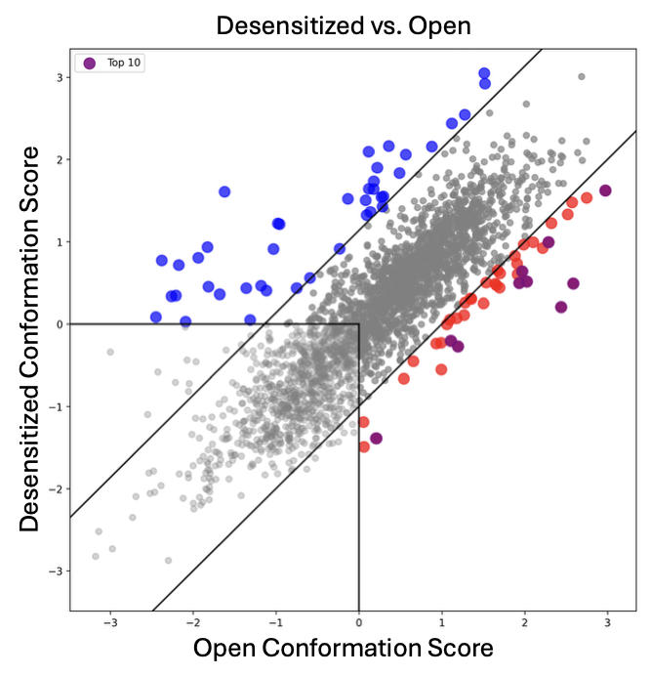
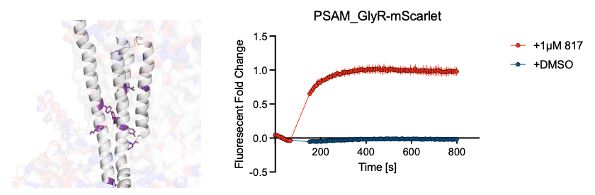
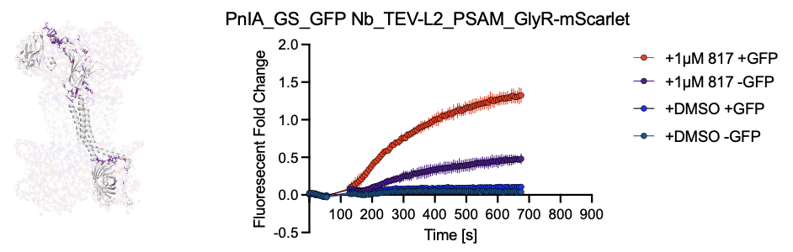
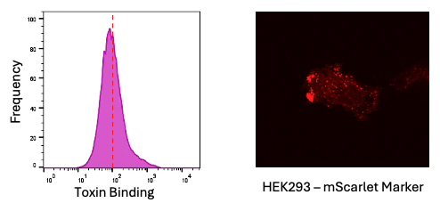
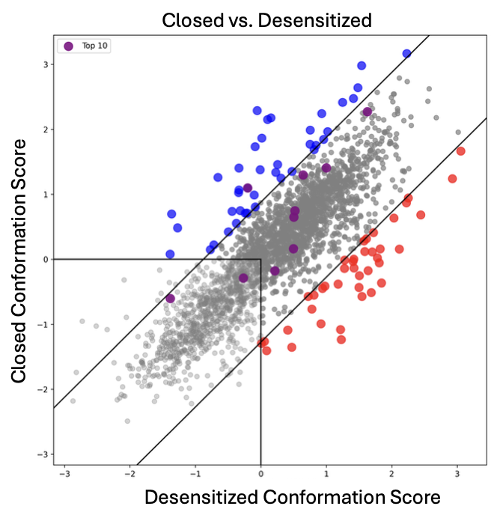
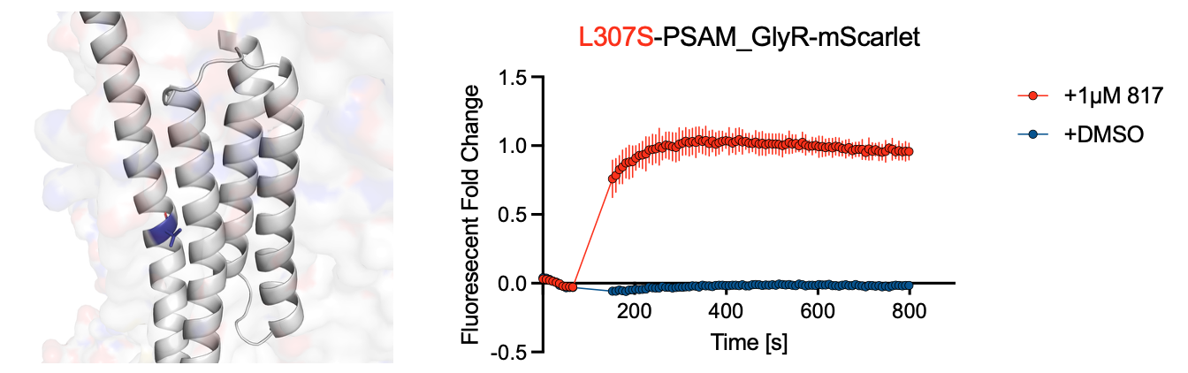
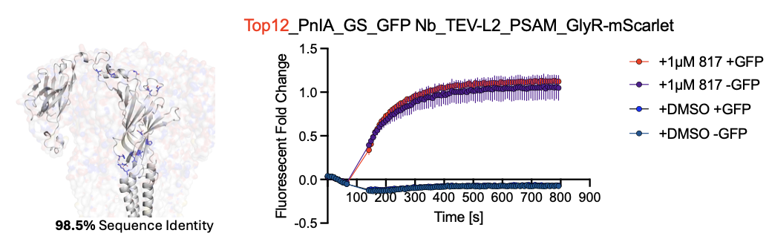
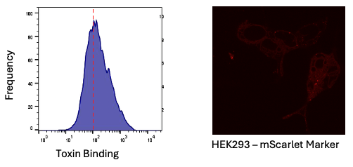
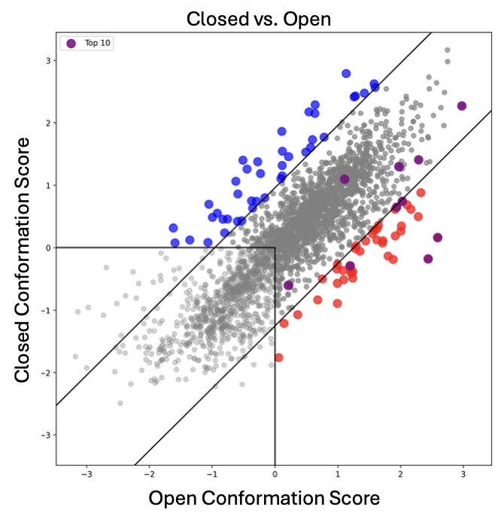
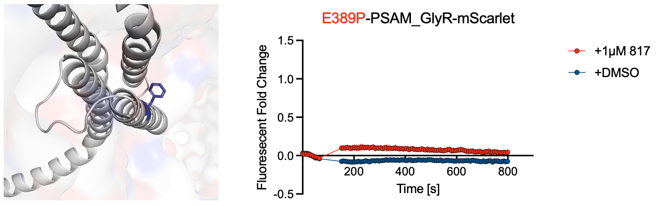
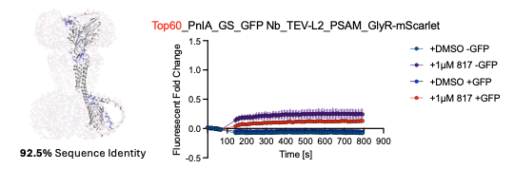
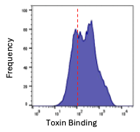
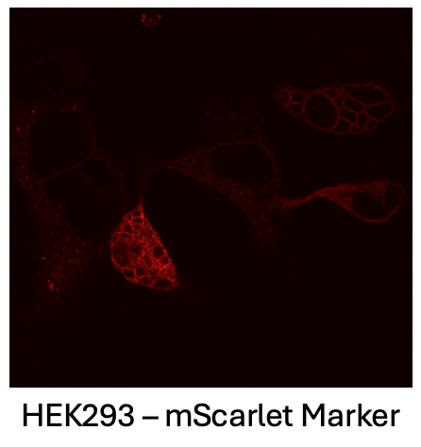
A
A
B
C
I
B
I
II
II
III
III

Slide 10
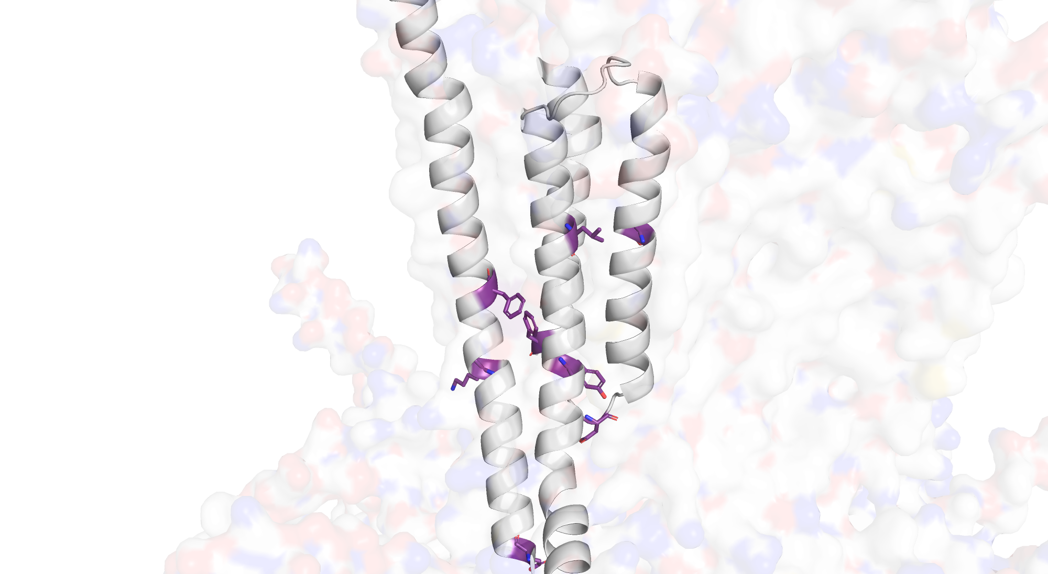
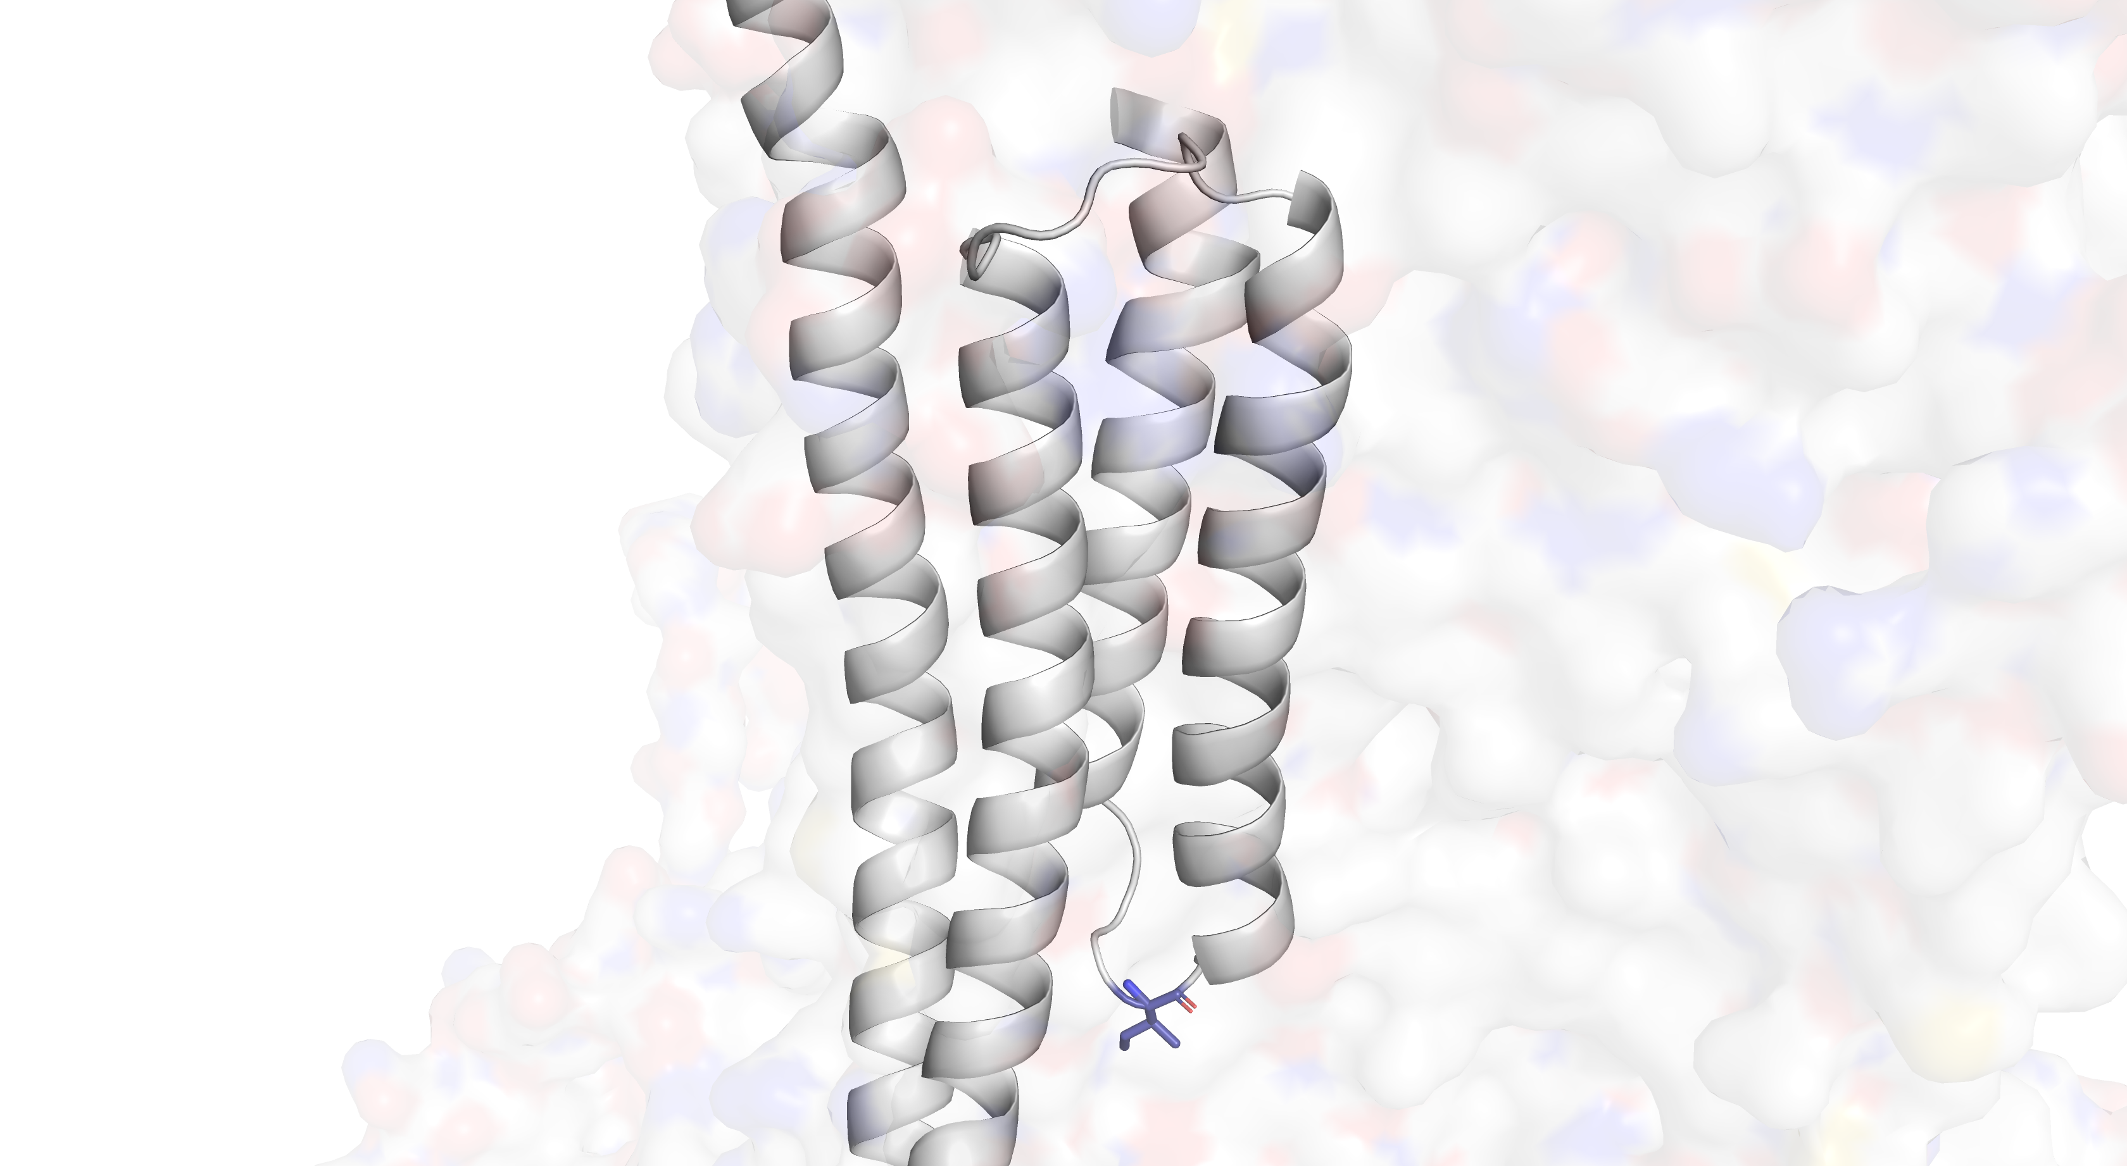
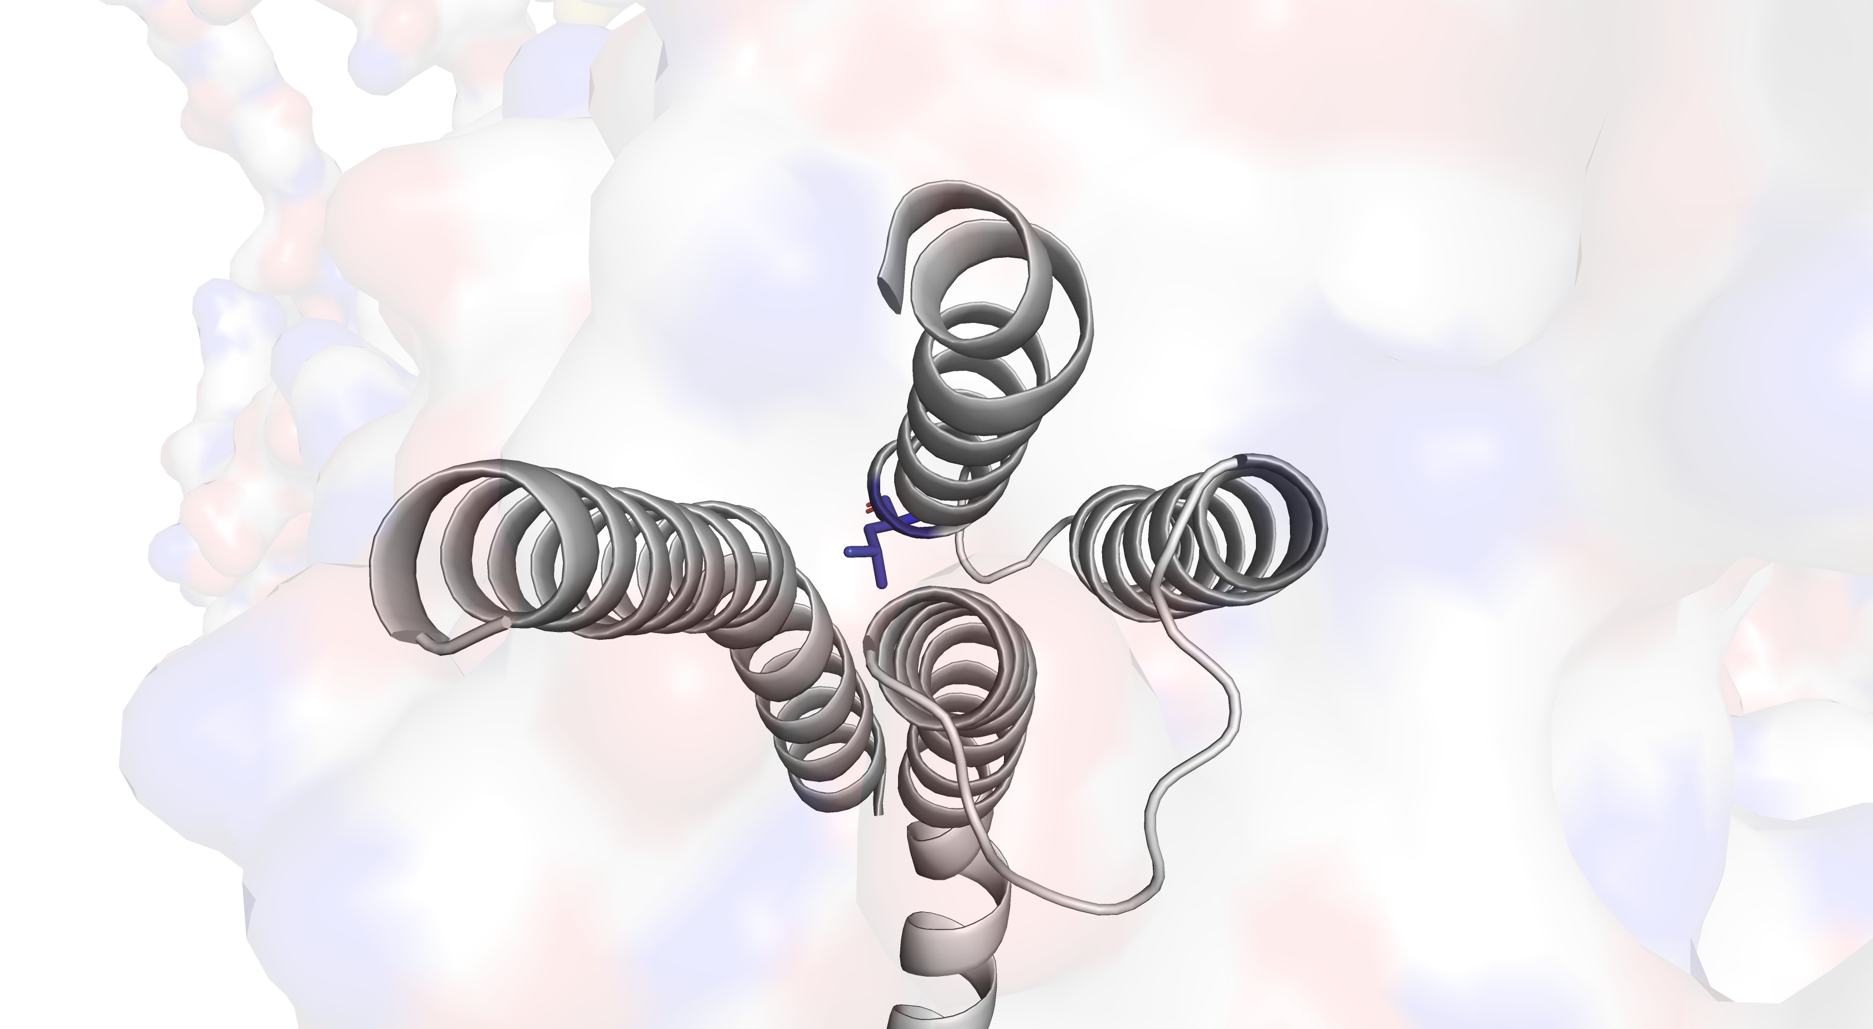
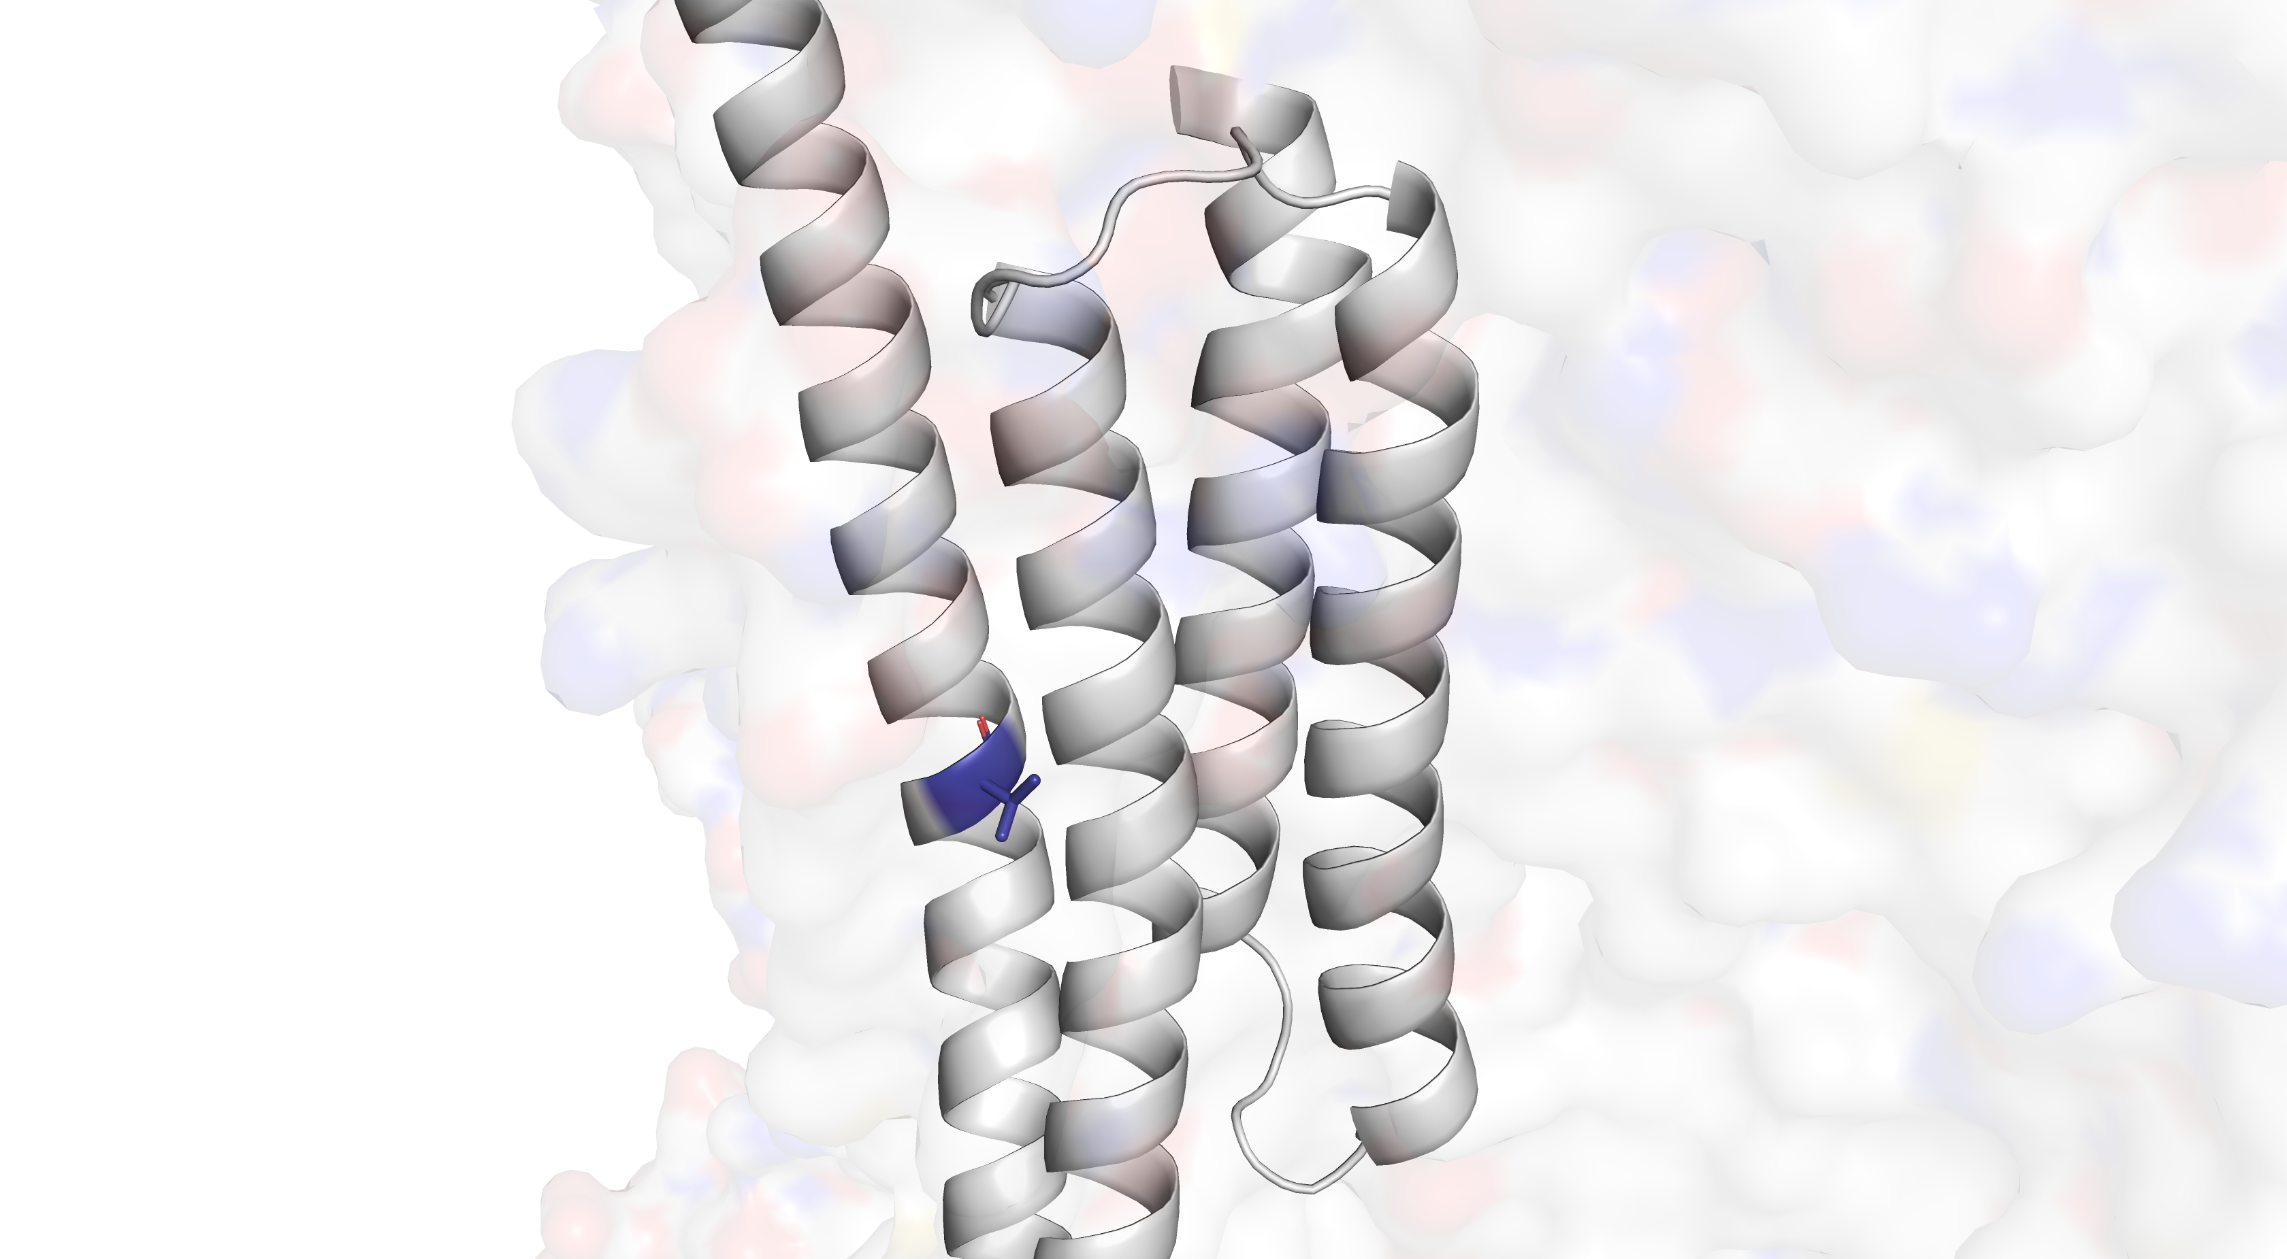
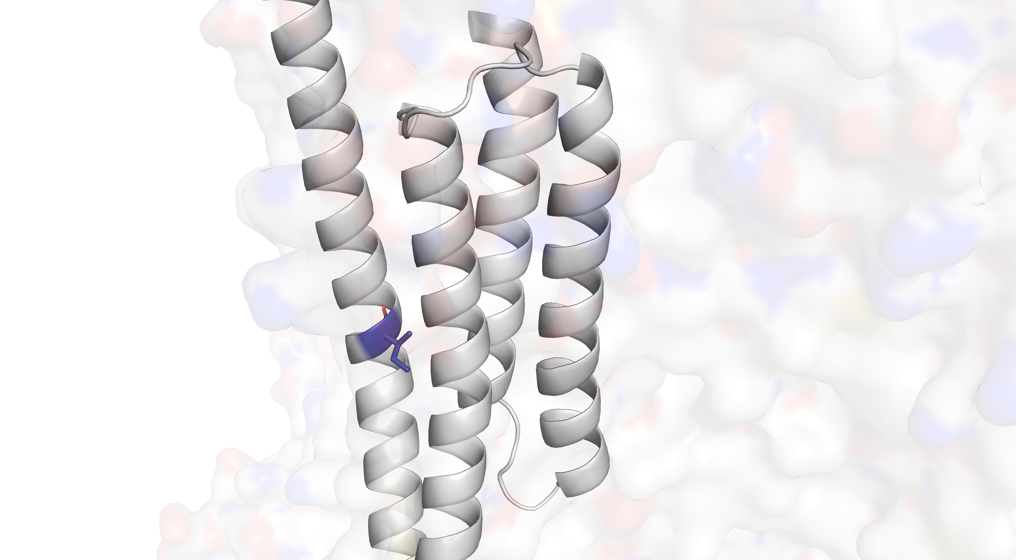
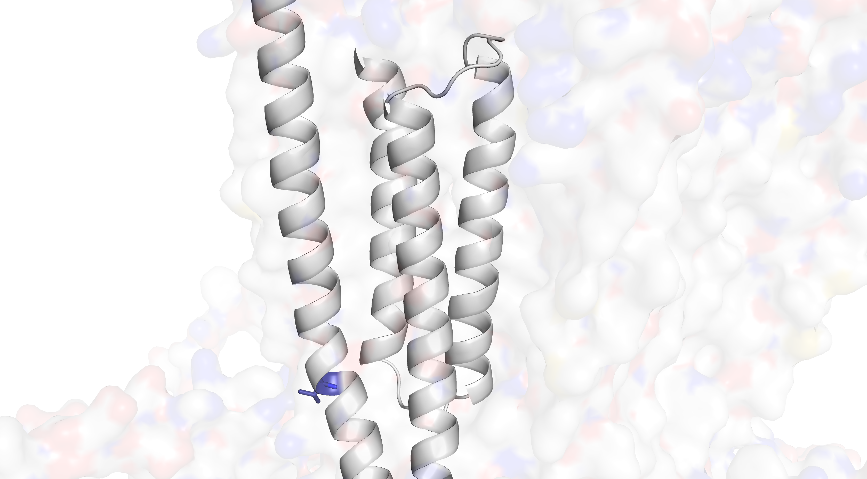
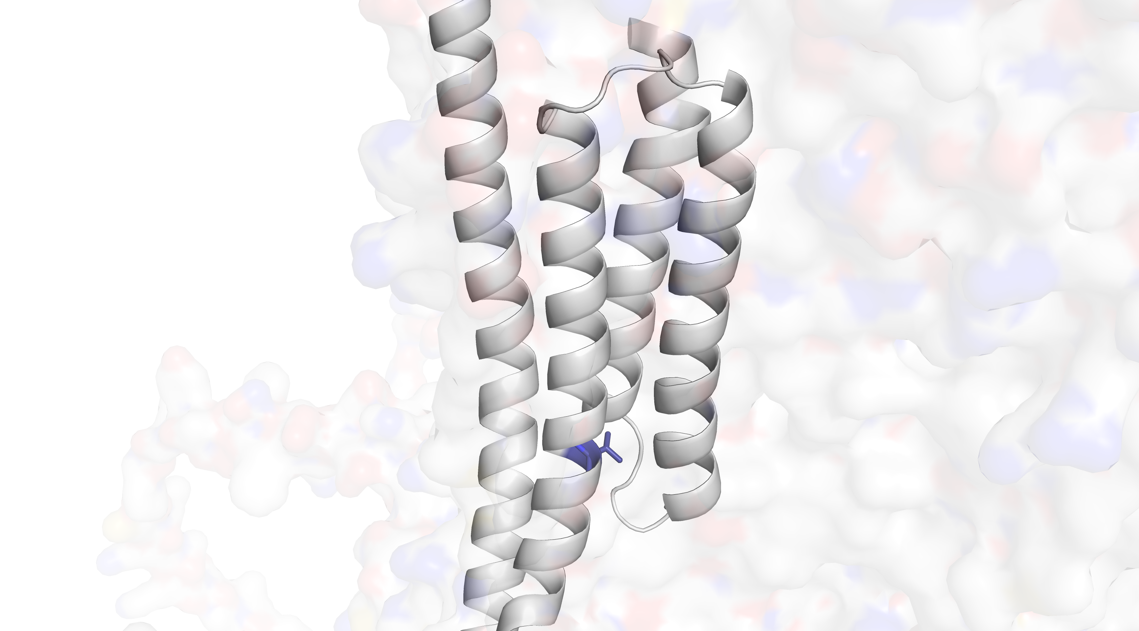
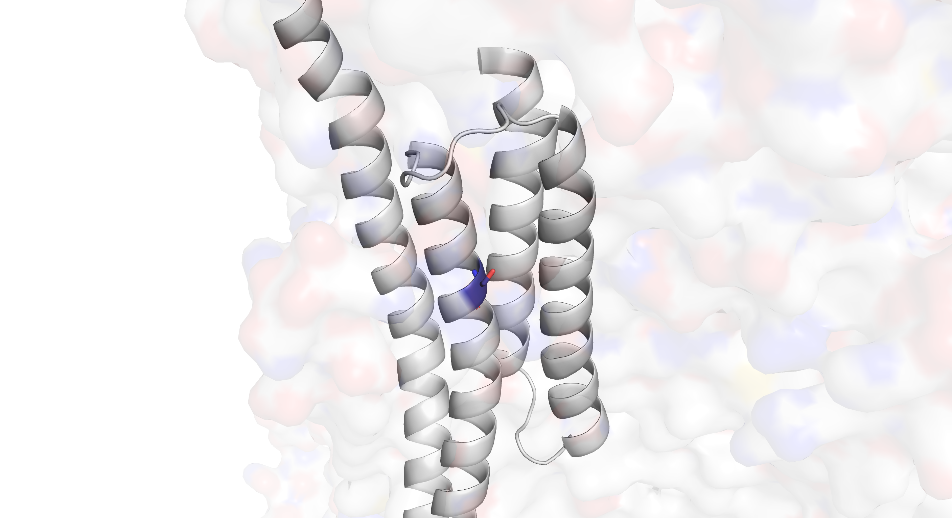
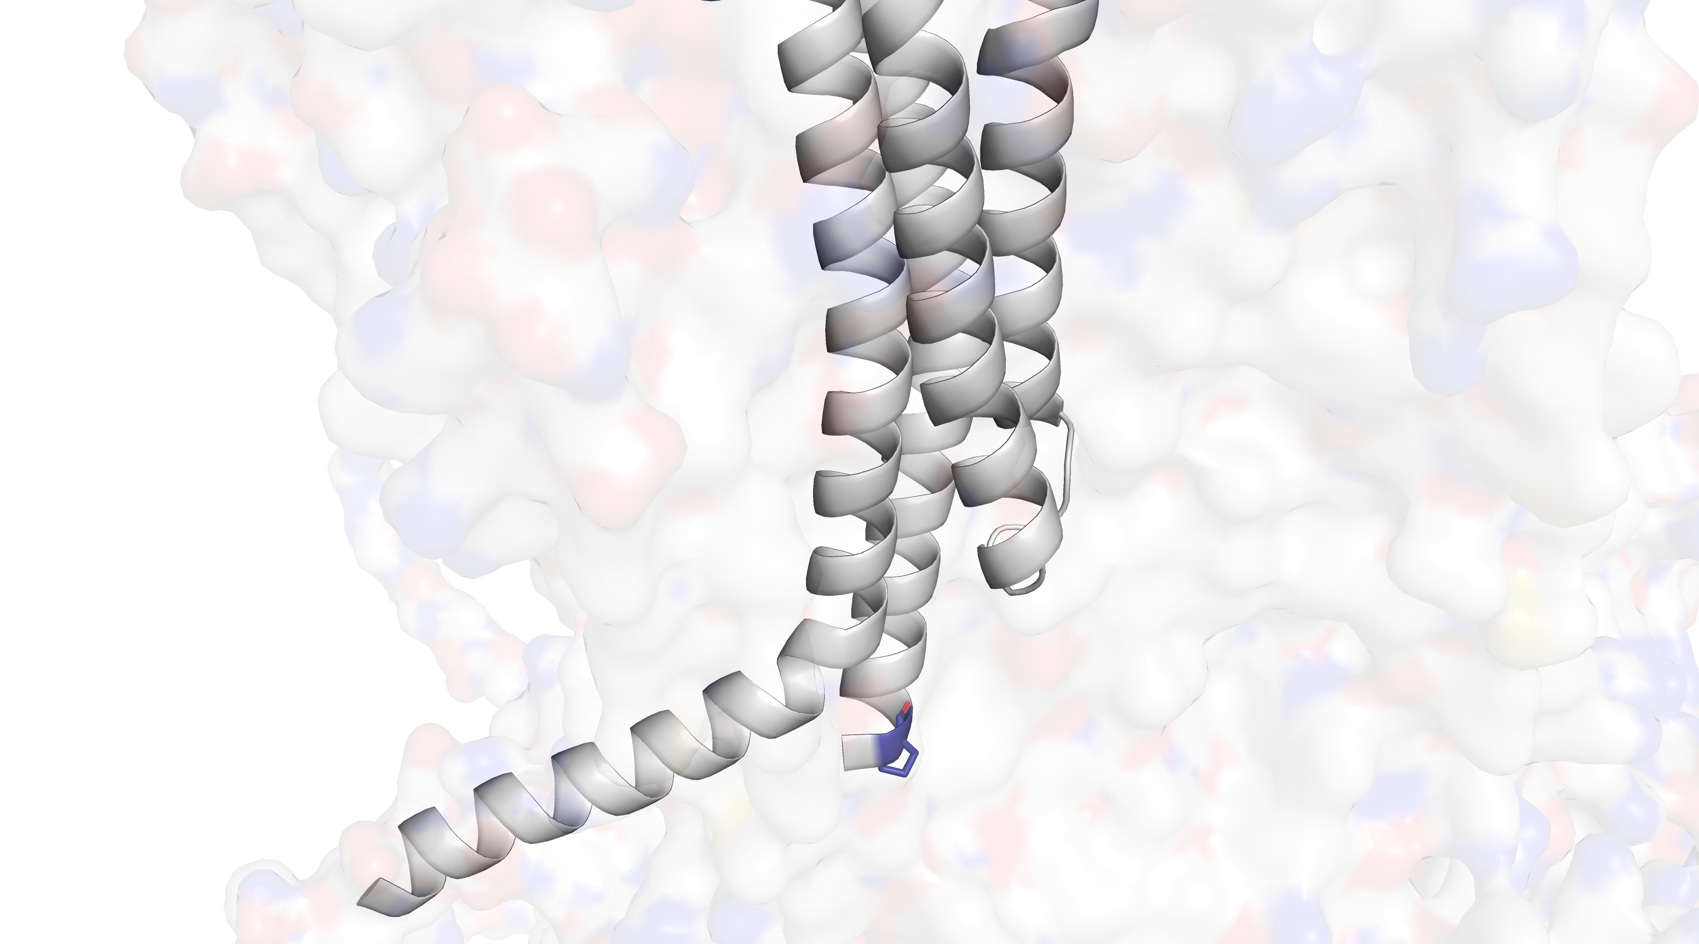
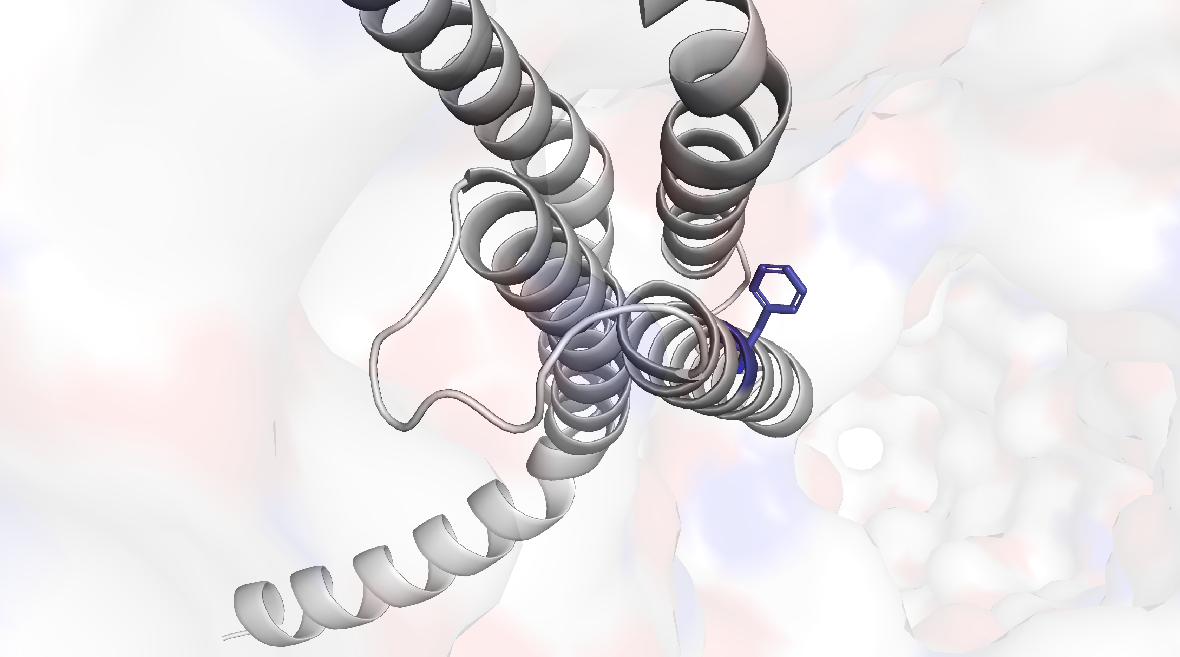
A
G
B
H
C
I
D
J
E
K
F

Slide 11
















A
Frequency
B
Toxin Binding
HEK293 – mScarlet Marker
Frequency
C
88.7% Sequence Identity
Toxin Binding
HEK293 – mScarlet Marker
Frequency
88.1% Sequence Identity
HEK293 – mScarlet Marker
D
Toxin Binding
Frequency
98.5% Sequence Identity
Toxin Binding
HEK293 – mScarlet Marker
E
Frequency
92.5% Sequence Identity
Toxin Binding
HEK293 – mScarlet Marker

Slide 12



Desensitized vs. Open
Closed vs. Open
Closed vs. Desensitized
Desensitized Conformation Score
Closed Conformation Score
Closed Conformation Score
Open Conformation Score
Open Conformation Score
Desensitized Conformation Score

Slide 13
A
A
AF3 structure
Initial MPNN preds
MPNN/ESM2 score filtering
3-states pymol
Top-10 Mutants
Final Structures
Filter by iPTM, pLDDT
Use AF2 to predict structures
B
C
B
WT
MP
pSAD306
FACS
Imaging
MP
D
1st best
C
MP
1st best
FACS
Imaging
MP
E
D
2nd best
MP
2nd best
FACS
Imaging
MP

